Slide 1
Healing Your Skin: What You Should Know About Pure Hypochlorous Acid
Presented by Carol Marshall-Hanson MSN RN CWON
Ostomy Association of Austin
March 2023

Slide 2
Disclaimer;
I do not work for Urgo, the maker of Vashe. I am not being paid by them to present this information.
I have presented several posters at wound care conferences depicting the results I and my colleagues have had using this product with the pediatric population.
Some photos are stock photos. Others are de-identified to maintain anonymity of the subject.
This information is presented as information only for the members of the Ostomy Association of Austin. It should not be construed as medical advise.

Slide 3
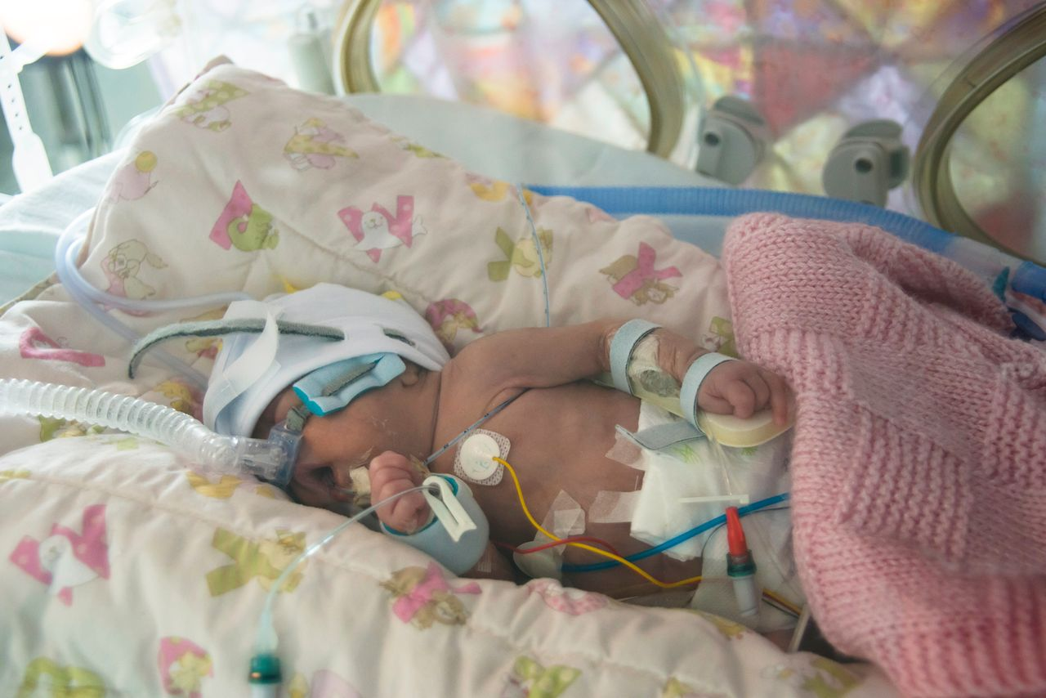
Vashe: A Pure Hypochlorous Acid (pHA)Product—What is it? Who Can Use it?
Marketed as a Wound Cleanser
Safe for all ages, even very premature infants
Safe for all tissues: Skin, Eyes, Perineal Area, During Surgeries

Slide 4
Why pHA over other “wound cleansers”?
Non-cytotoxic (spares fibroblasts, macrophages, keratinocytes)
Antimicrobial preservative with broad spectrum effects (fungi, bacteria, viruses) and disrupts biofilm.
Mildly acidic pH: Comfortable application to open skin/mucous membranes (minimize pain).
Requires no dilution, no rinsing.
Can be slightly warmed (40 C) without adversely impacting the above actions (avoid hypothermia in ELBW infants).
Notes:
As a wound care nurse, we get called when the traditional things aren’t working.
When I graduated nursing school, the term “advanced wound care products” didn’t exist—because the products didn’t exist. (Wet-to-dry or antibiotic ointment). Now we have to come to conferences every year to keep up with the new evidence and new advanced wound care products available.
When first introduced to pHA: these are the attributes that made it attractive as a wound cleanser for infants and children.
Hard to do studies on neonates and infants who cannot speak to tell you what hurts, but can tell from other signs (physical reaction and VS).
Started using 6-7 years ago and gained confidence with results and how well tolerated.

Slide 5
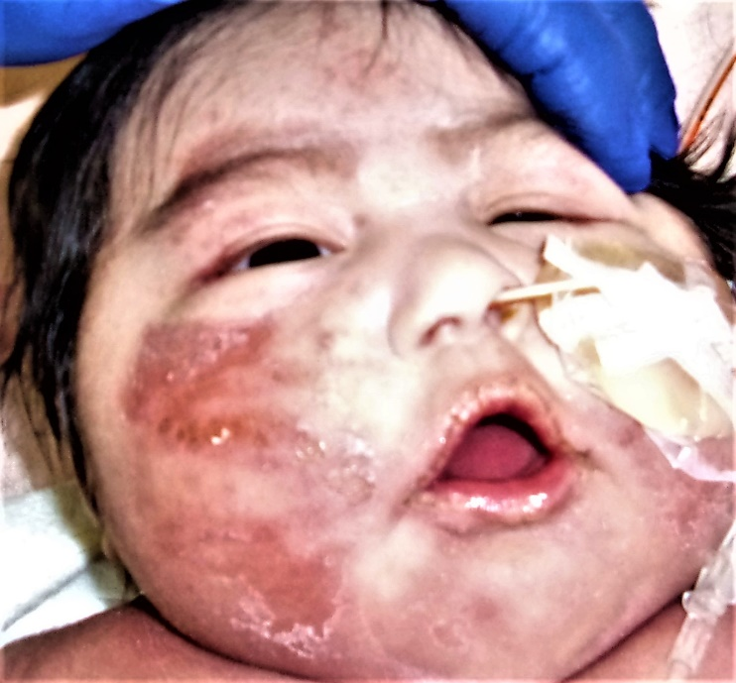
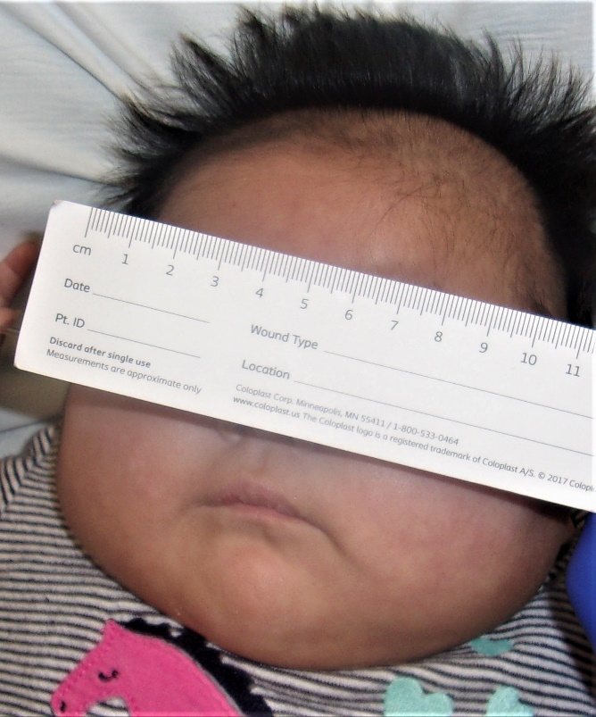
Genetic Disorders can also have skin manifestations
2 week old infant with previously undiagnosed genetic disorder
Medical treatment ensued to correct the disorder
Wound/Skin care included pHA
Admission
12 days later

Slide 6
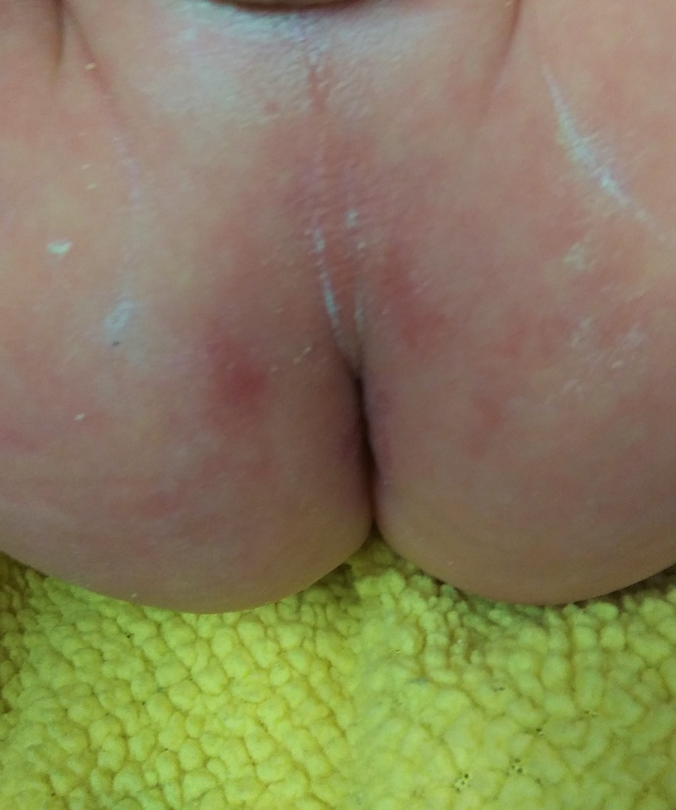
Incontinence Associated Dermatitis (Diaper Rash)
Prior to Starting pHA
After 5 days of adding pHA with Diaper Changes for skin cleansing

Slide 7
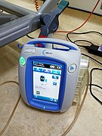
Also used as instillation solution with Negative Pressure Wound Therapy (NPWT) or “Wound VAC” therapy
May be inpatient or outpatient for helping close surgical wounds, especially if there was contamination.
Example: Ruptured area of the bowel with stool contamination into the abdomen

Slide 8
There are many uses for pHA.
Incontinence Associated Dermatitis (Diaper rash)
Moisture Associated Skin Damage (MASD) (Peristomal skin erosion)
Staph Scalded Skin Syndrome or Stephen Johnson’s Syndrome (peds)
Surgical wounds (prevention/treatment of SSI (surgical site infection)
Labial/Perirectal Abscesses
Pressure Injuries
Burns; rashes
Epidermolysis Bullosa (peds)
Mucositis
Daily bathing for antimicrobial bath (if Sensitive to CHG)

Slide 9
Your hospital or wound care clinic may or may not use Vashe. Sometimes this is because a product is not “on contract.”
Your physician may have to order it.
For personal use: You can find it online, such as Amazon.
Comes in sizes (4oz, 16oz, 1L, and maybe other sizes).

Slide 10
Beware of Sound-Alike Products: Patient Educate Thy Self
There are products on the market they say they have hypochlorous acid as an ingredient, but the products are not strictly “pure hypochlorous acid” or pHA.
Some wound cleansers are a combination of hypochlorous acid and hypochlorite (Dakins; aka-Diluted Bleach)
The problem with solutions that contain hypochlorite and other agents such as betadine or chlorhexidine is that these products kill the good cells trying to heal the wound at the same time they kill the ‘germs”.

Slide 11
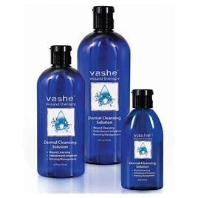
Protect from light; No Rinsing, No Dilution
Protect from extreme Heat (stable to store at temps to 40 C (104 F)
Used to say discard open bottle after 30 days.
Now the manufacturer has rescinded this and states solution in an open bottle is still effective.
**If using for a sterile procedure(such as a central line dressing), using a new 4oz bottle is recommended by practitioners but no such statement is made by the company.

