Slide 1
Treating the Person with Disease, not the Disease Itself
Notes:
Don’t believe me. Try it out, experience. That tops any medical degree

Slide 2
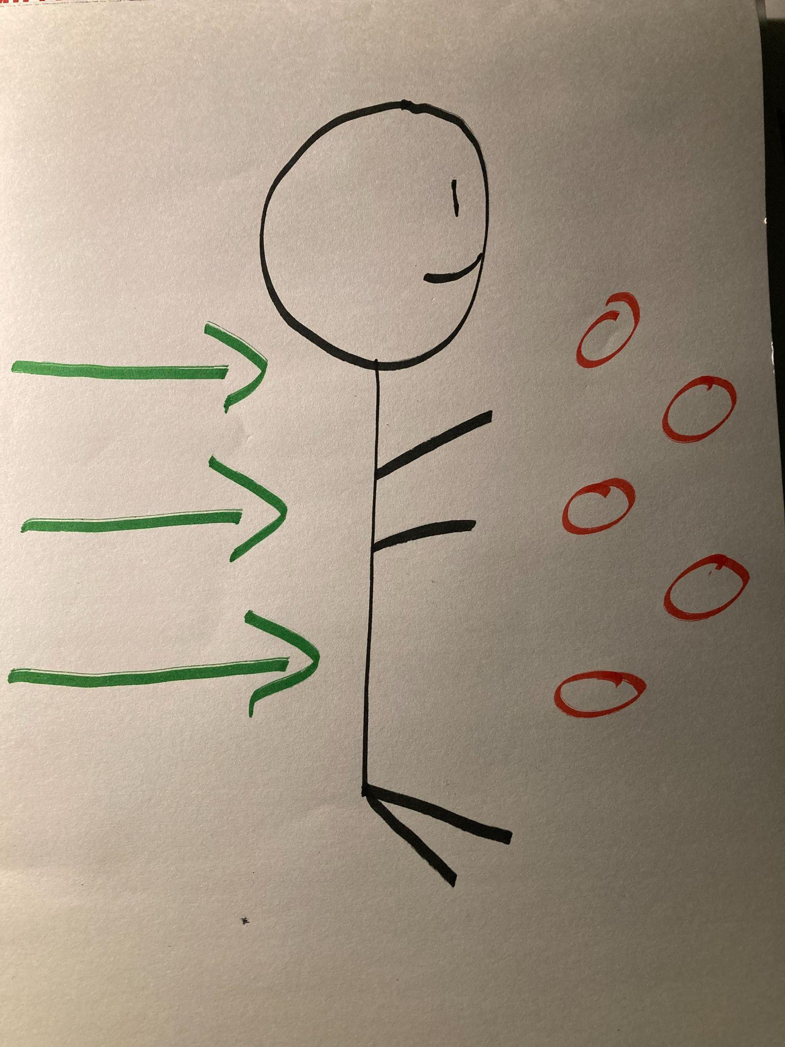

Slide 3
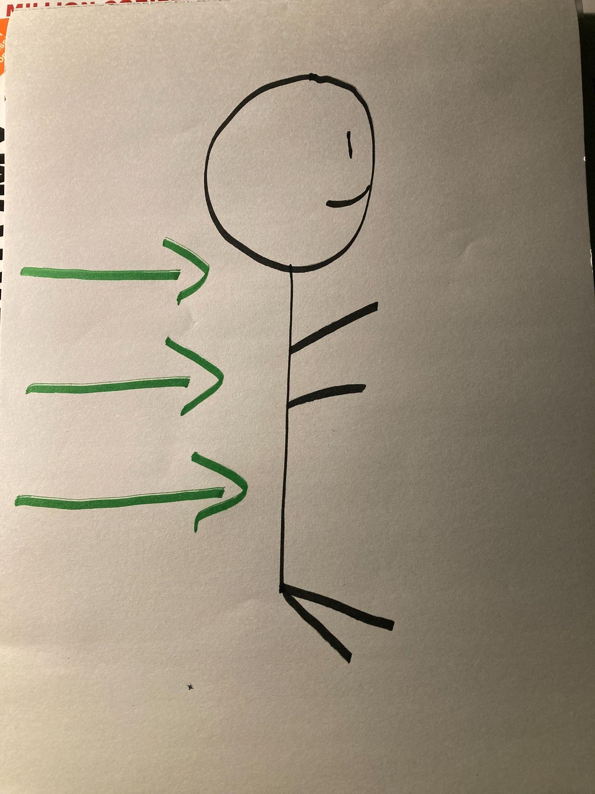

Slide 4
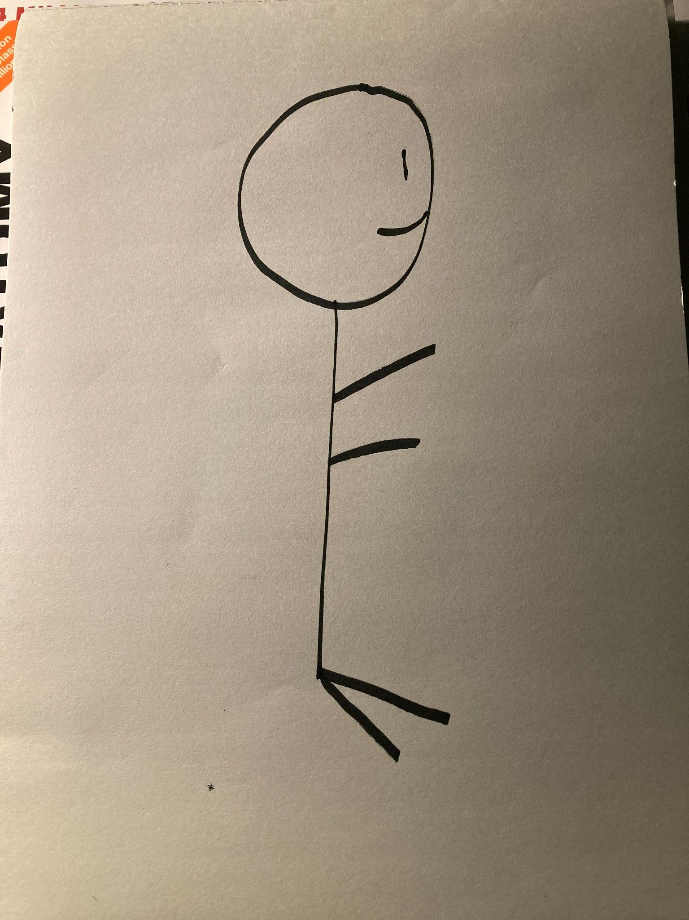

Slide 5
What We’ll Cover
Nutrition, Hydration, and Situational Supplementation
Physical Considerations and Specific How To’s
Five Types of Stress
Emotional, Mental, and Happiness Components
Our Dreams
Notes:
These relate to our chronic pain, fatigue, weight gain or loss, not knowing what to do or thinking I’m out of options

Slide 6
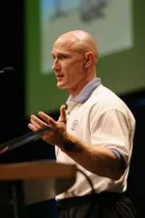
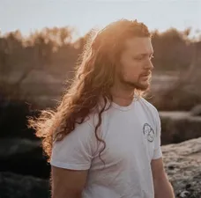
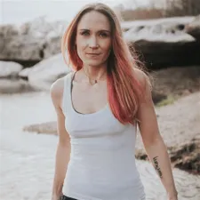
If you’re not Assessing you’re Guessing
Most Doctors treat symptoms
Root Cause takes time
It’s different for everyone
Notes:
With doctors we’re get 30 minutes if we’re lucky and they have a limited toolkit. Colorectal surgeons and GI doctors have two tools surgery and medication. When your only tool is a hammer everything looks like a nail

Slide 7
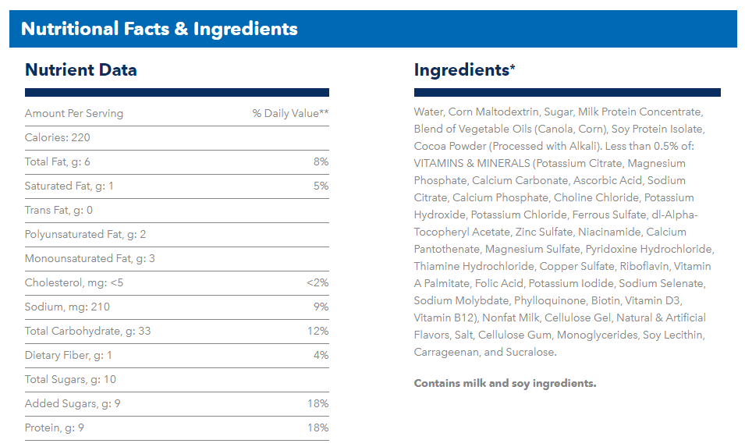
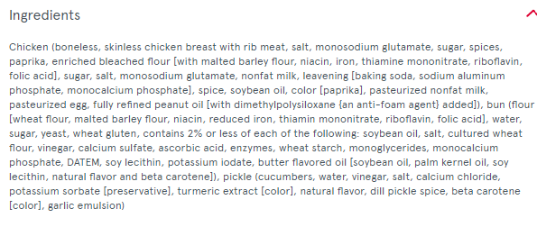
Nutrition
Everyone has unique needs
Ingredient quality > Macros
Gluten
Dairy, Whole
Living vs dead (pasteurization)
Why we feel bad when switching
Ingredient quality > Macros
Example of Labels
Intuitive eating
Tracking calories trains body wrong

Slide 8
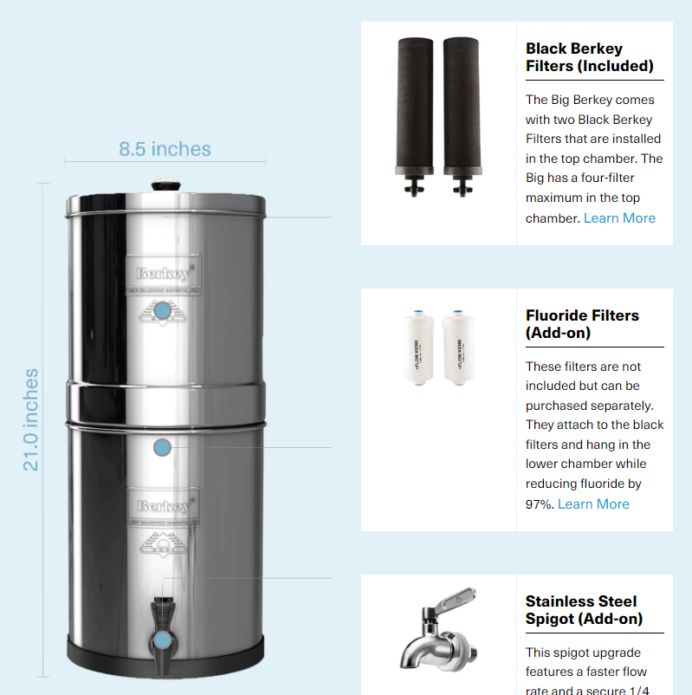
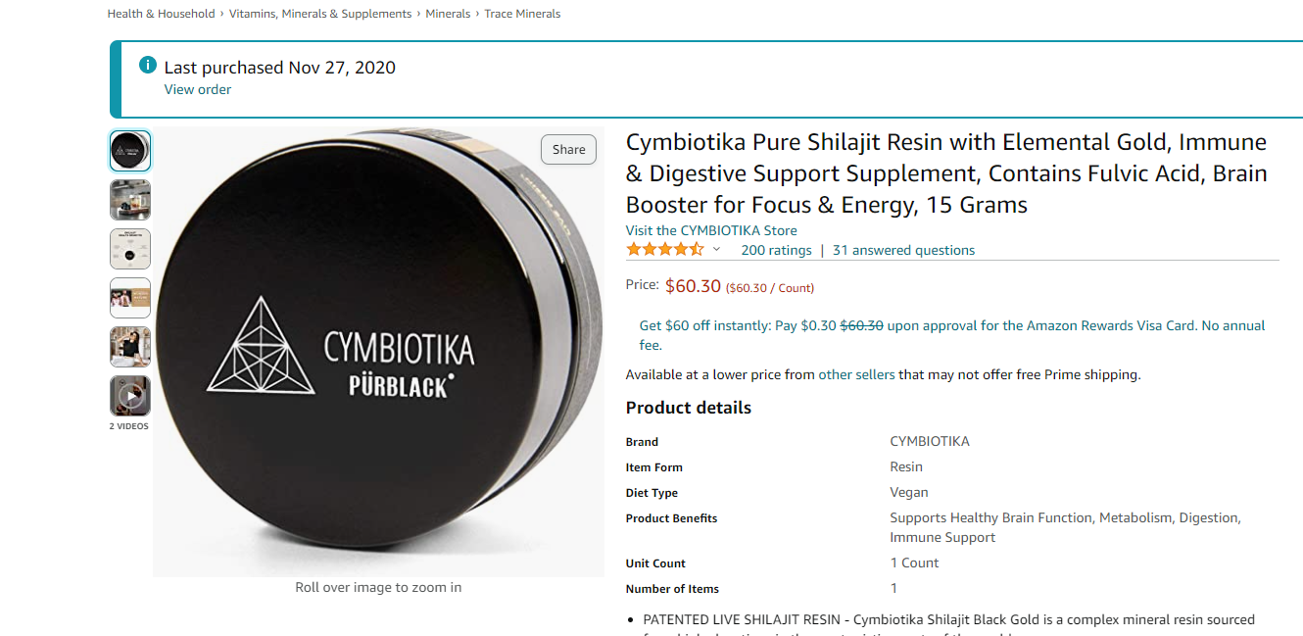
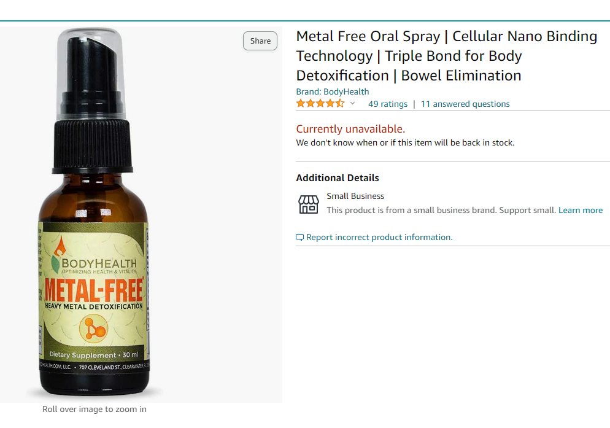
Hydration and Situational Supplementation
Proper water
Half
10-20 min
Colon absorbs
Filtration
Digestive Enzymes
Process fat
Blood loss/Anemia
Wound Healing
Metal Detox
KlenzTea

Slide 9
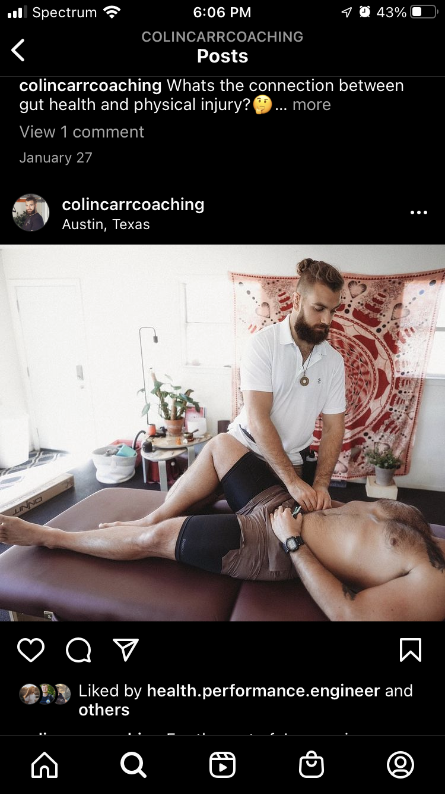
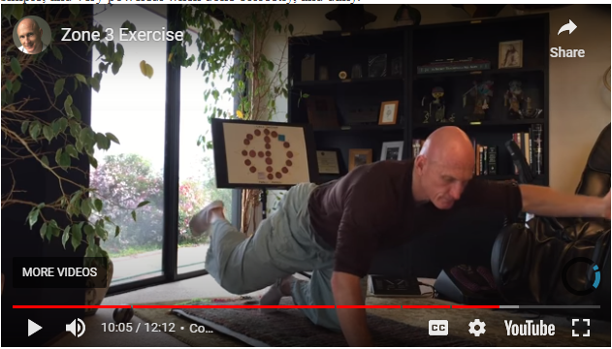
Physical Considerations
Zone exercises
Grounding in earth
Light , Cortisol
Breathing properly
Neurosomatic Therapy

Slide 10
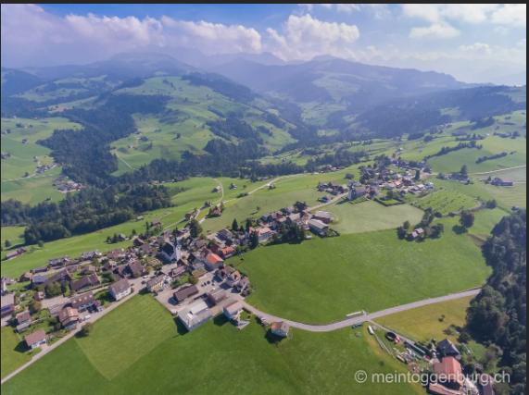
Five Types of Stress
Physical
Chemical
Electromagnetic
Psychic (Fear)/Mental
Nutritional
Notes:
Enviornmental factors, all things you consume

Slide 11
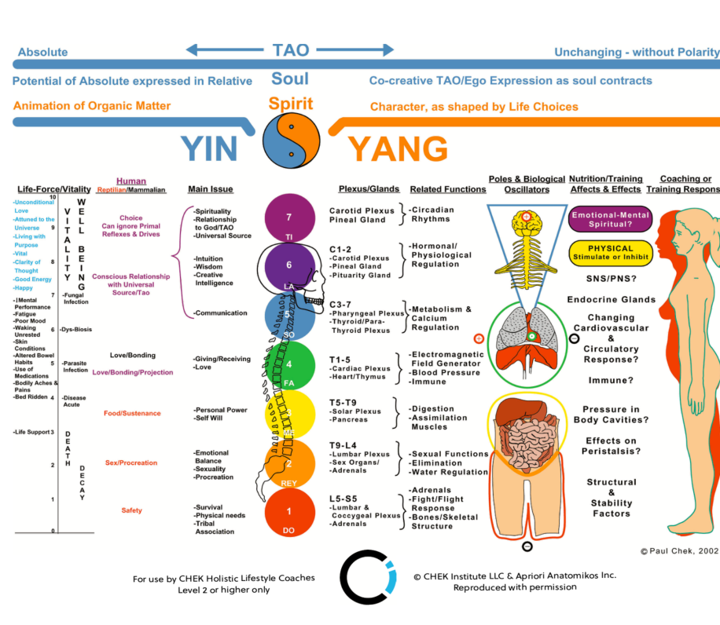
Emotional, Mental, Spiritual, and Happiness Components
Chronic (Permanent)
What do I feel I can’t change?
Coin drill
Body mind linked
Our interpretation
Denial for self-preservation
Colon
Breathing, fear, worry, will
Processing thoughts
Learn to make decisions
Duck bill
Pendulum
What is it trying to say
Others make decisions

Slide 12
Our Dreams
I am
When you have big enough dream you don’t need a crisis
All real change is because of two things
If you don’t have a vision any path will get you there
Letting go and subconscious
Talking to water
RAS
JT Boone @jtboone jboone44@gmail.com
Notes:
Recap what we went over

